Slide 1
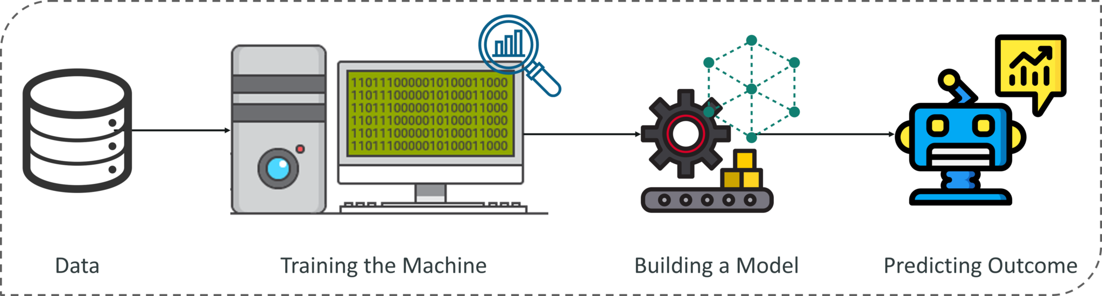

Slide 2
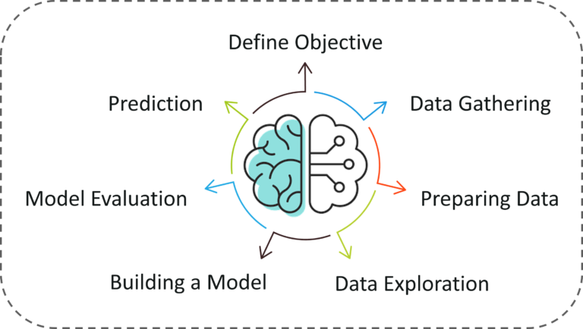
Machine Learning Process

Slide 3
Machine Learning Types
A machine can learn to solve a problem by following any one of the following three approaches. These are the ways in which a machine can learn:
Supervised Learning
Unsupervised Learning
Reinforcement Learning

Slide 4
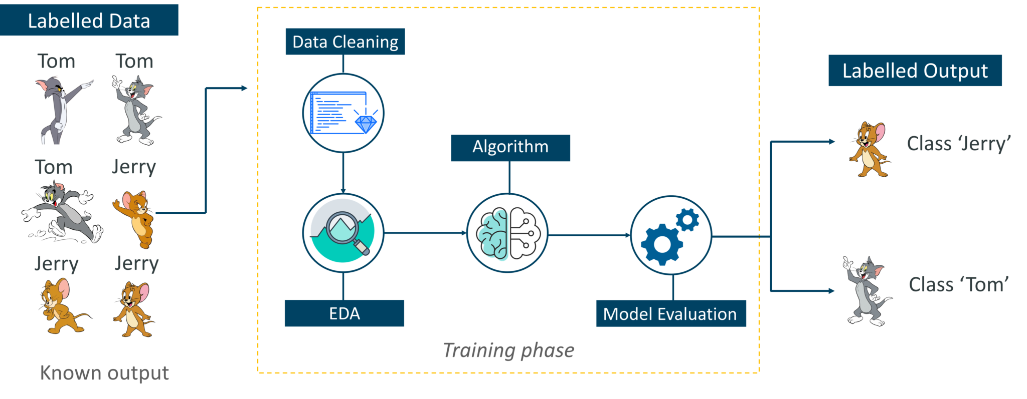
Supervised Learning

Slide 5
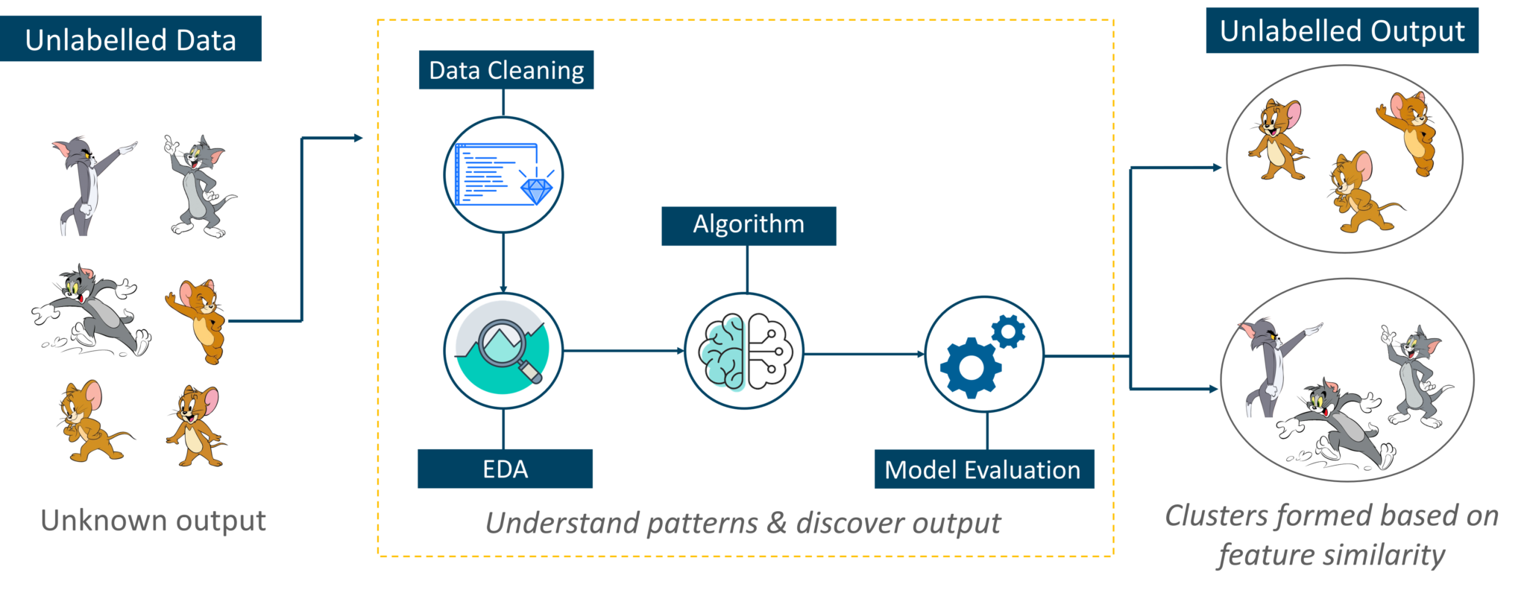
2. Unsupervised Learning

Slide 6
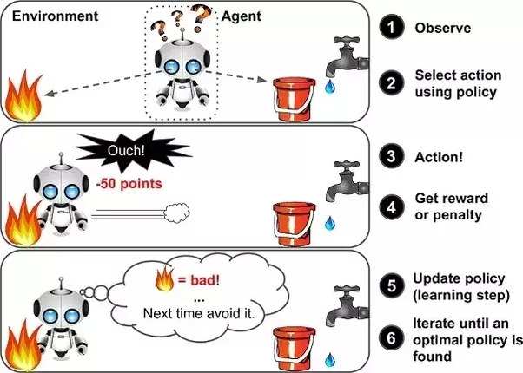

Slide 7
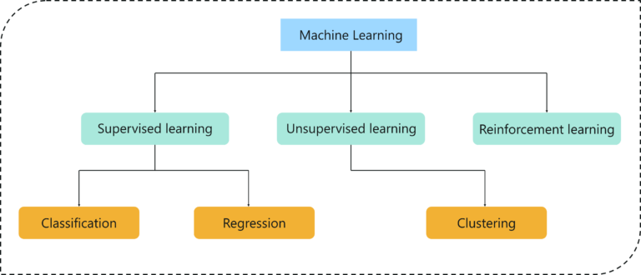
Type Of Problems In Machine Learning

Slide 8
